Slide 1

Python

Slide 2
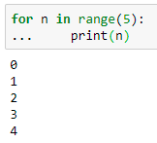
Q1
If you are displaying values in a loop, the values will be displayed on individual lines
We need to display the values on one line, rather than on individual lines
Expected Output

Slide 3

Q2
Display float number with 2 decimal places using print()

Slide 4

Q3
Accept a list of any float numbers as an input from the user
For example 5 numbers

Slide 5
Q4
How to check file is empty or not

Slide 6
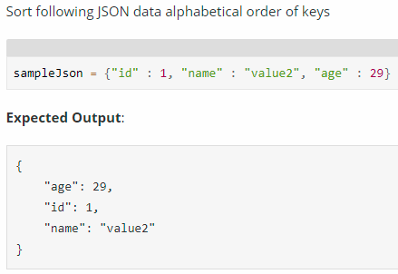
Q5
Sort JSON keys in and write them into a file

Slide 7
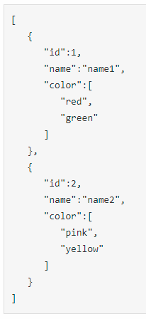

Q6
Parse the following JSON to get all the values of a key ‘name’ within an array

Slide 8
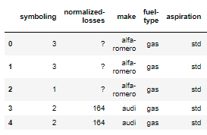
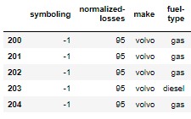
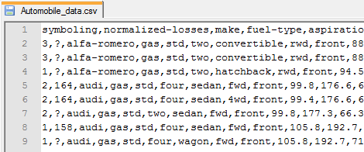
Q7
From the given dataset print the first and last five rows
Automobile_data.csv

Slide 9
THANKS!
ANY QUESTIONS?

